Slide 1
Atlantic Link
New England Electricity Restructuring Roundtable
October 6, 2017
www.atlanticlink.com

Slide 2
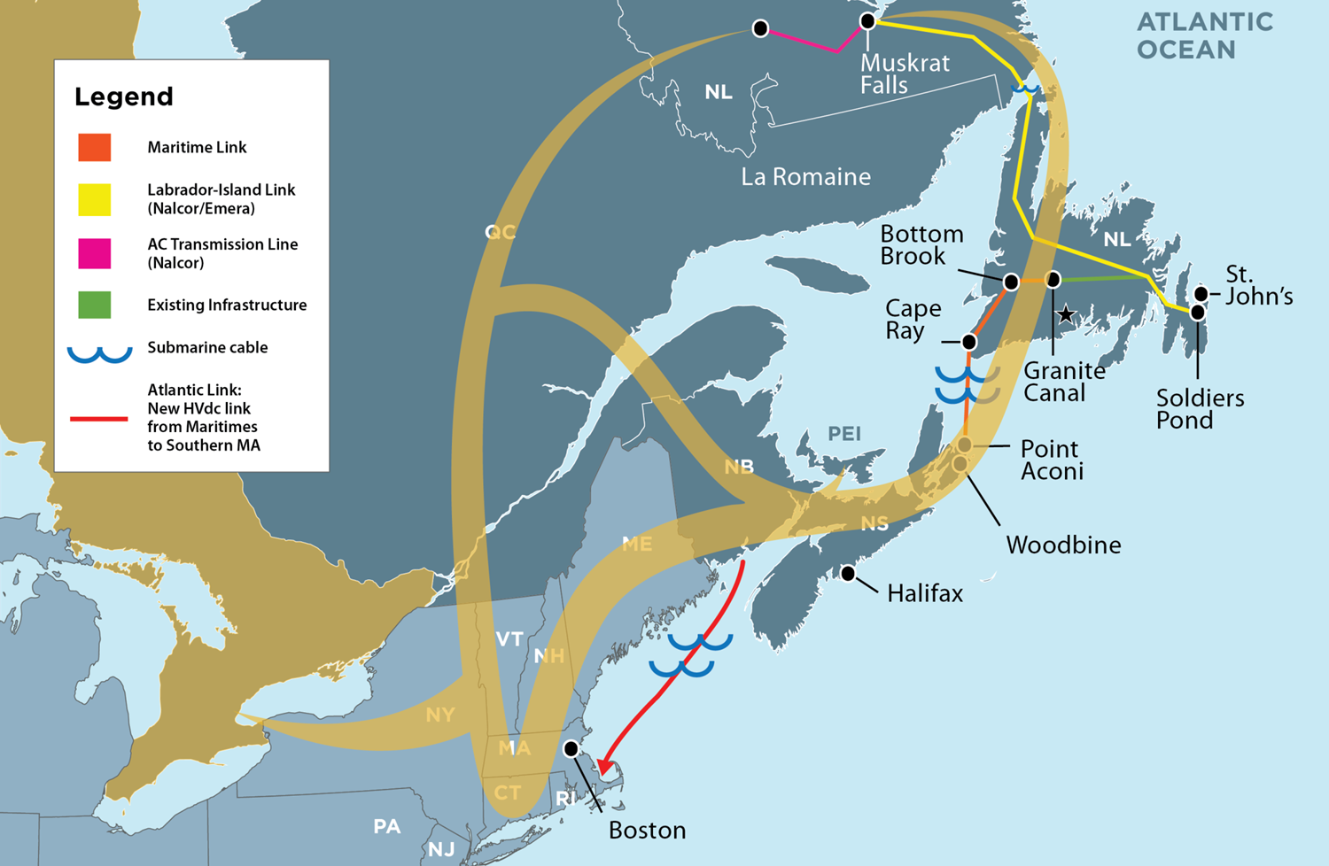
North American Eastern Energy Loop

Slide 3
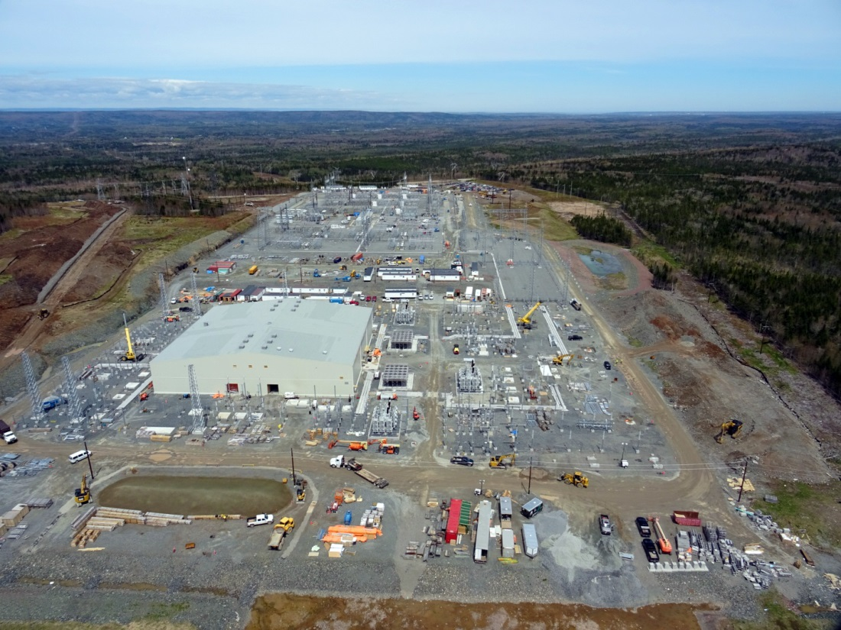
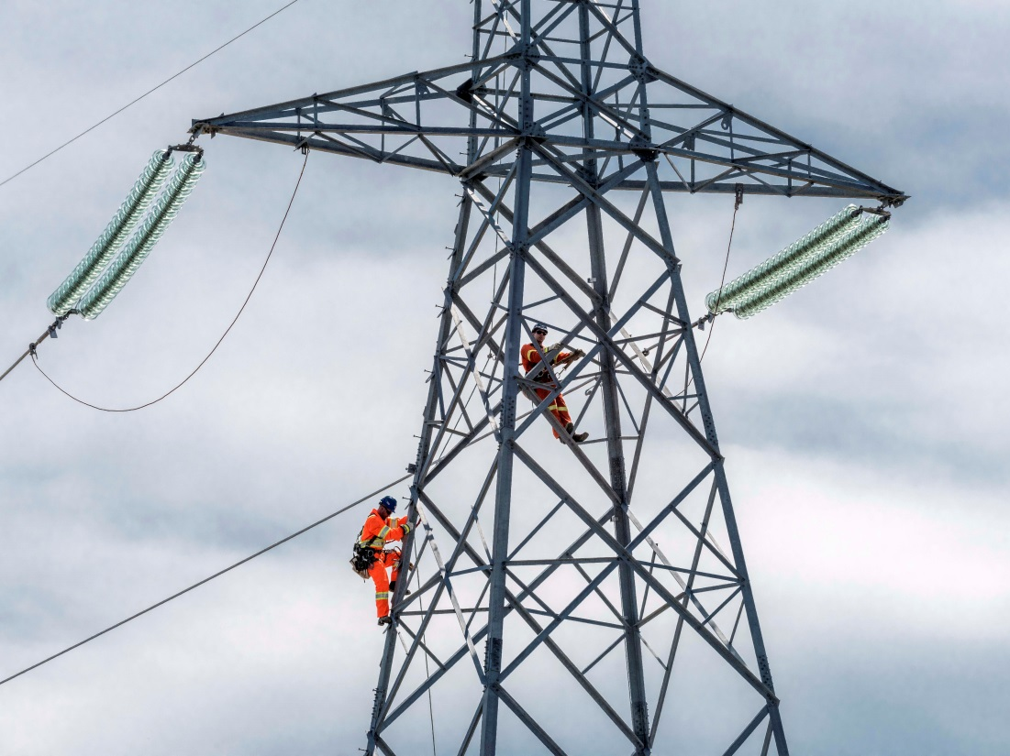
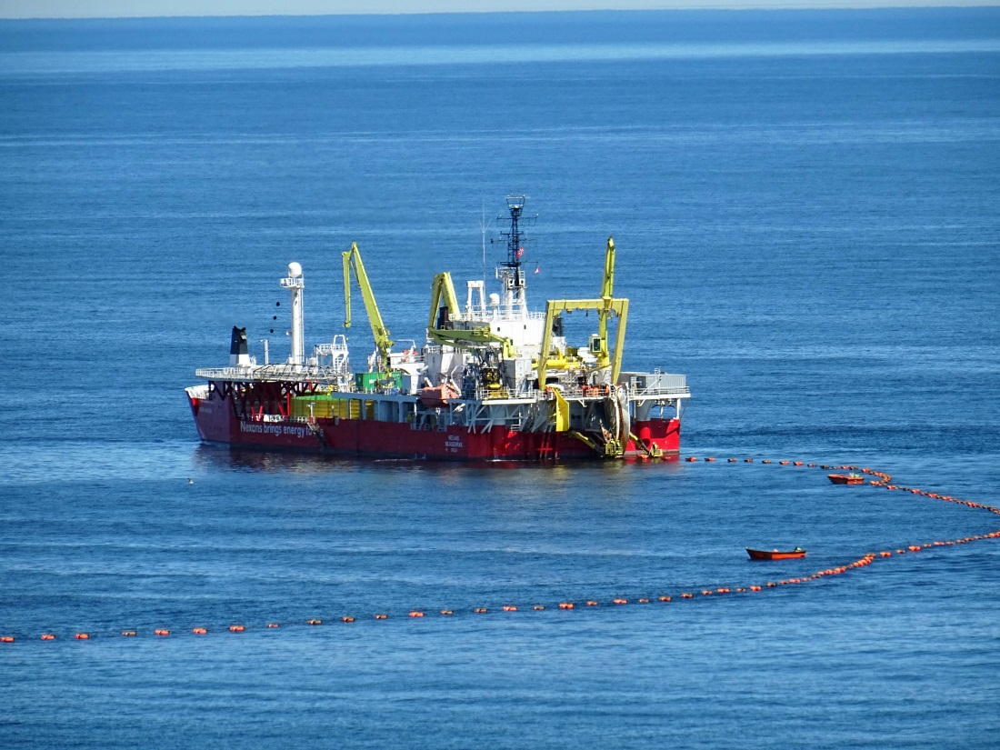
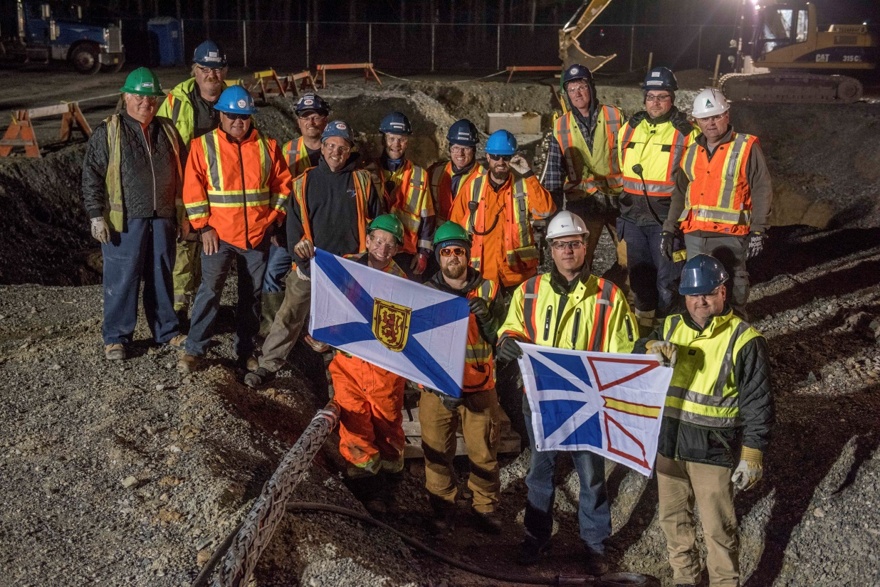
Maritime Link

Slide 4
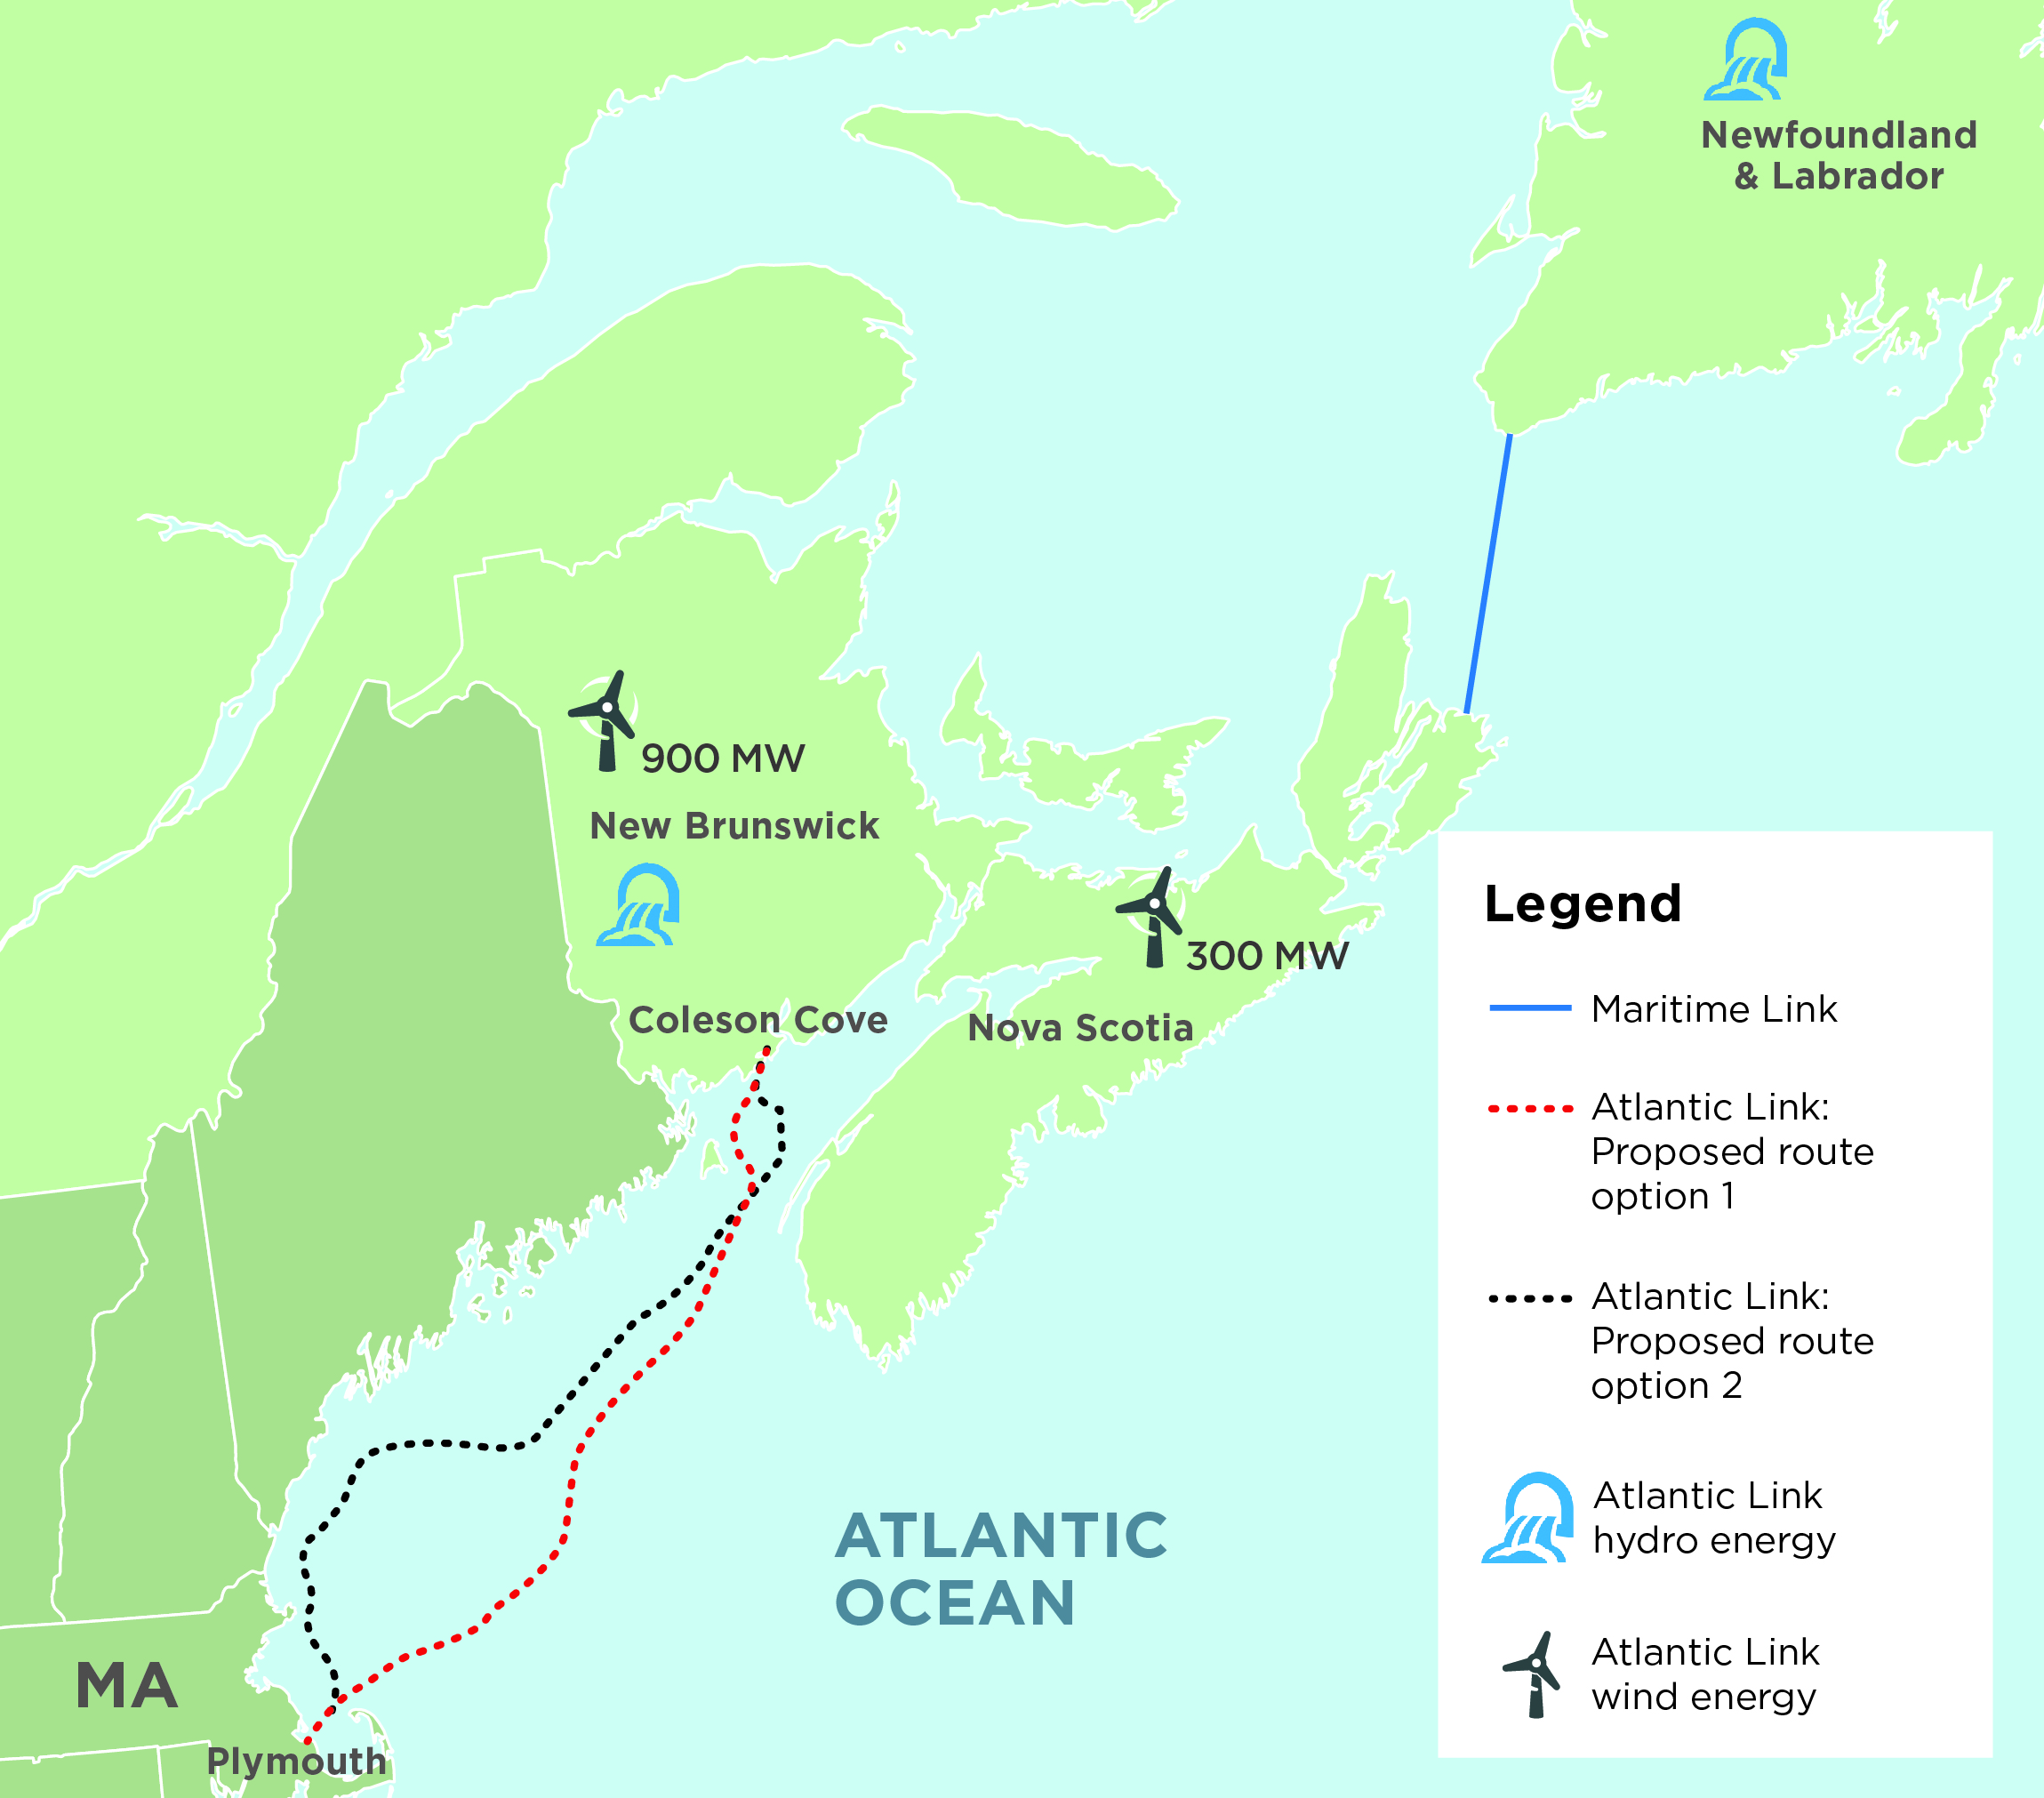
Atlantic Link – Route Proposals

Slide 5
Atlantic Link – Project Overview
Approximately 375-mile high HVDC subsea interconnection
clean energy from Atlantic Canada directly to Massachusetts, for a delivered price that remains fixed for 20 years
Landing site in Plymouth, near the Pilgrim Nuclear Station
Commitment: 5.69 TWh annually (similar to annual Pilgrim production)
70% from seven new wind farms in New Brunswick and Nova Scotia (IPPs)
Remainder will be hydro from Nalcor Energy and NB Power
Capital investment, 900 construction jobs, tax revenue, low-income benefits for Massachusetts
Opportunity for additional energy to move on Atlantic Link
In-service date is late 2022

Slide 6
